Slide 1
Capstone Project – Predicting R&D Expenditure
By Iwan Williams

Slide 2
Nature of the field, Background
Niche Industry
Uncertainty of the end-goal of our product
Client engagement

Slide 3
The data set
Summary of claimable costs
Cost brackets
Extraction
Client data

Slide 4
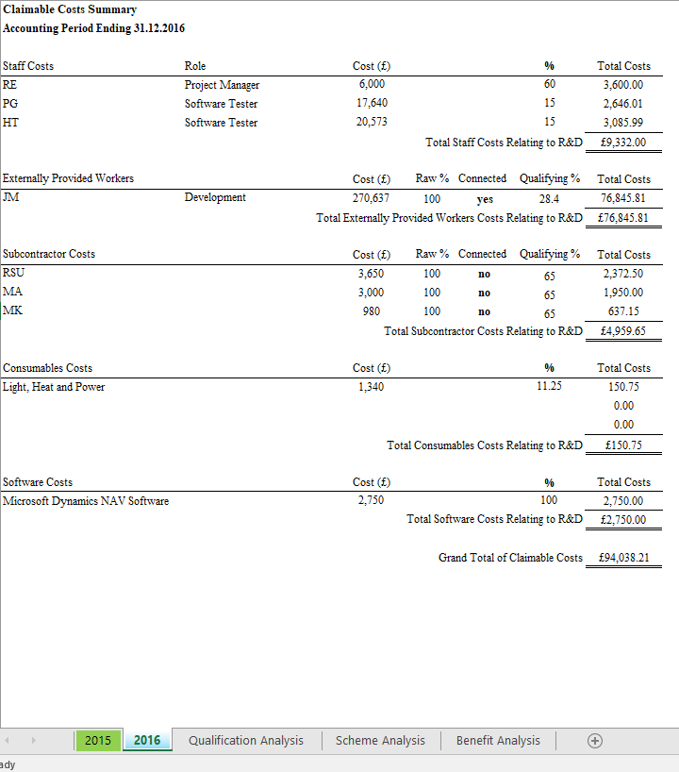
Wrangling the costs
Extracting all the datasets
Specifying and extracting using labels, keeping source data
Cleaning, validation, restructuring
Identifier extraction
Final cleaning
Differences between cost brackets

Slide 5
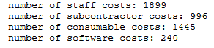
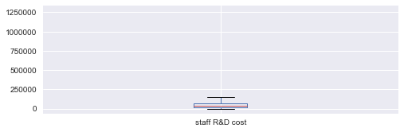
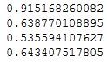
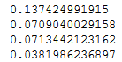
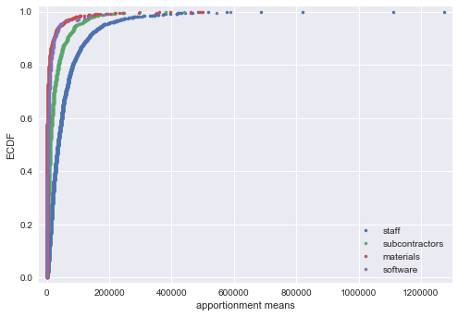
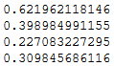
Analysis of the expenditure data
Huge variation, low mean, exponential distribution
Similarities of consumable and software data
Cost characteristics and correlations
Cost values correlation
Apportionment values correlation
Cost count correlation

Slide 6
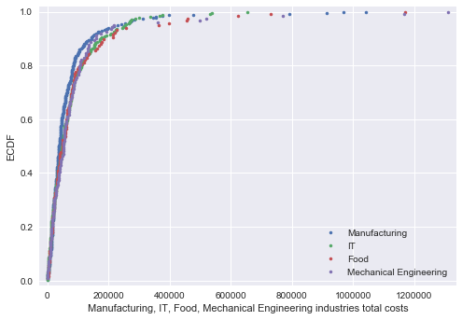
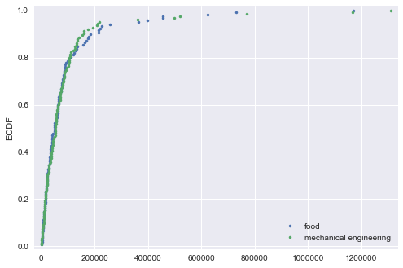
Analysis of the client data
Distribution of biggest industries
Similarities of Food and Mechanical Engineering
Correlations of client data to total costs

Slide 7
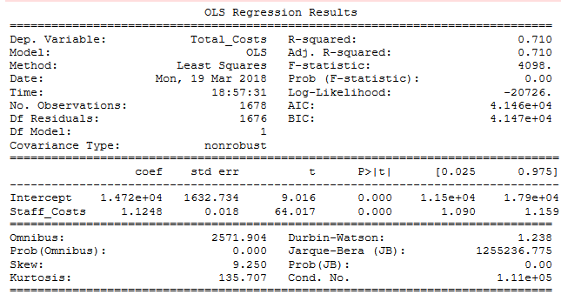
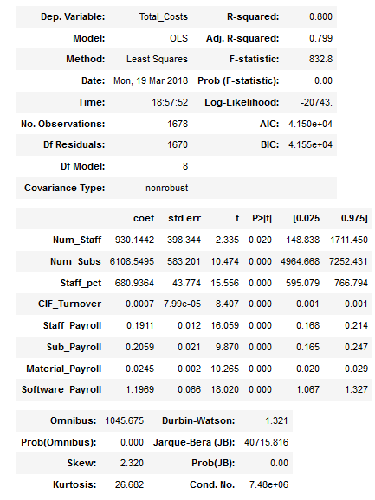
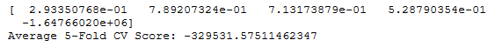
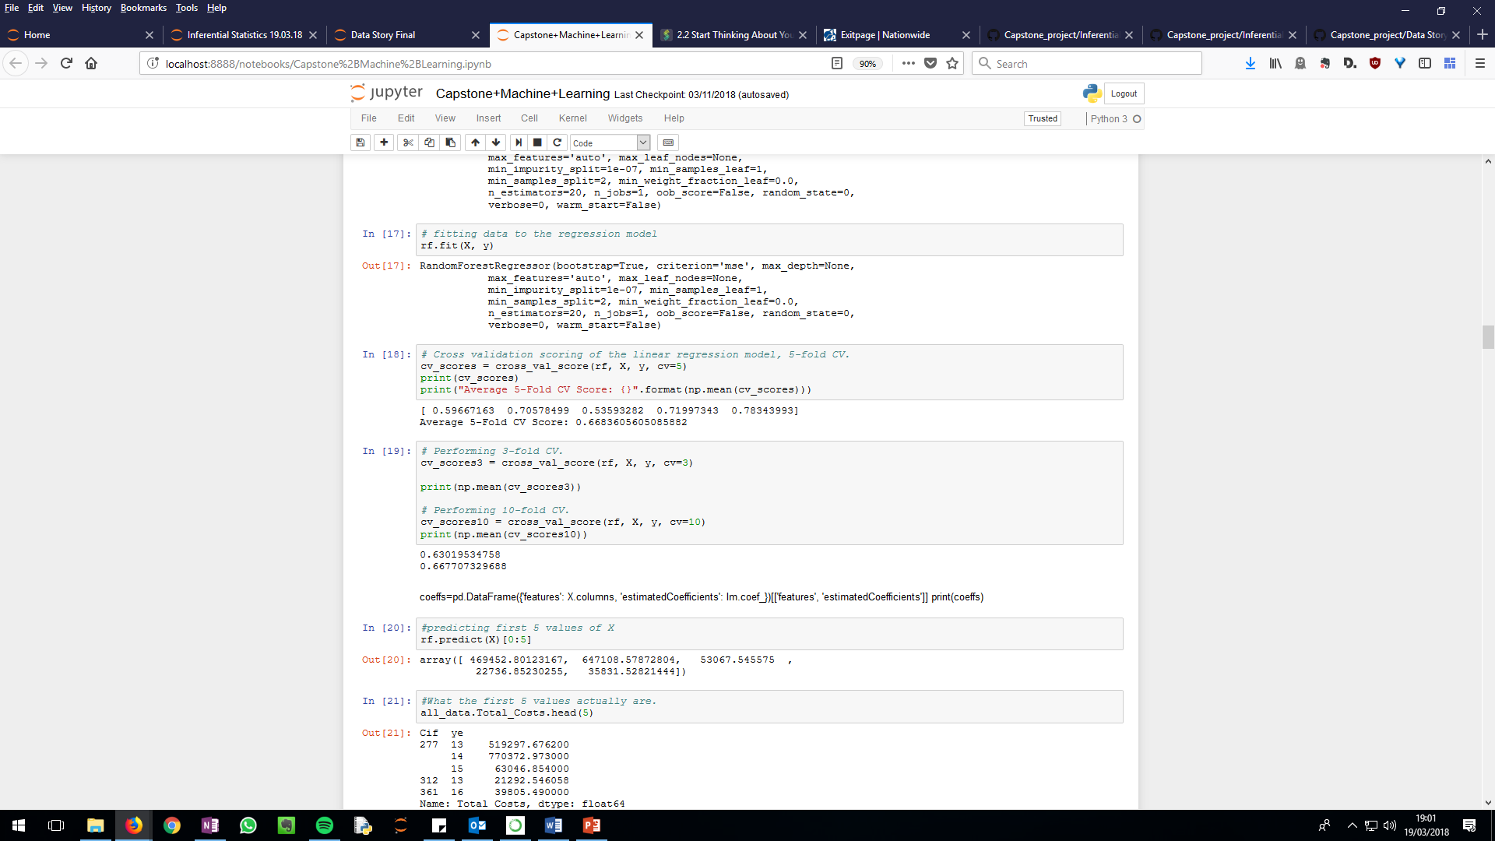
Machine learning - Regression
Putting it all together
Regression - Testing staff cost variable and all other costs
Removing low p value features and test
Final features and further tests with linear regression and random forest regression
Staff costs regression results
Regression cv test with different models. (all data without the costs).

Slide 8
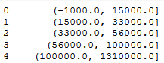
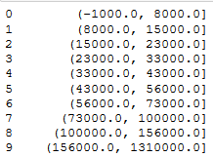
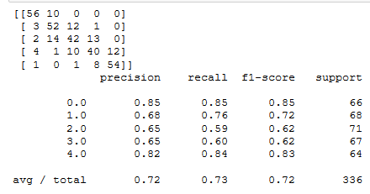
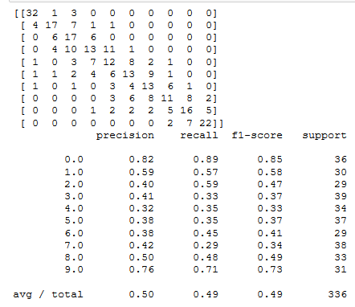
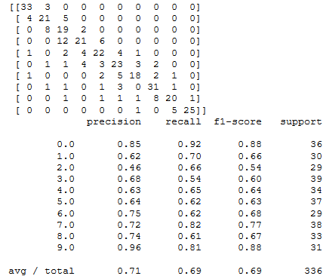
Machine learning - Classifying
5 bin model
10 bin model
Binning the data into a small set and testing
Binning the data into a larger set and testing
Preferred number of bins identified, and using a RBF classifier
Testing the model with staff costs
Staff costs included model

Slide 9
Results
Predicted cost data is exponentially distributed.
Industry, CIF data, phase and postcode are not great predictors.
Preferred algorithm is the random forest regressor/ classifier.
Foundation to predict expenditure without the cost data itself.
Several potential models with different strengths.
Models to be used by per process stage.

Slide 10
Recommendations
Use better identifiers for the cost data sources.
Field test with the different models and at different stages of the process.
Integrate with visualization tools to present to the client along with a benefit calculation tool.

Slide 11
Further improvements
Need for more data
Scoping for more features
Data set of the typical predicted values from the onset of the process
Enhancing industry specific data- breaking down the industries

